Slide 1
Busting .NET Myths
Jason Bock
Practice Lead

Slide 2
Personal Info
http://www.magenic.com
http://www.jasonbock.net
https://www.twitter.com/jasonbock
https://www.github.com/jasonbock
jasonb@magenic.com

Slide 3
Downloads
https://github.com/JasonBock/
BustingDotNetMyths
https://github.com/JasonBock/Presentations/blob/master/Busting%20.NET%20Myths.pptx

Slide 4
Overview
Goals
Myths
Summary
Remember…
https://github.com/JasonBock/BustingDotNetMyths
https://github.com/JasonBock/Presentations/blob/master/Busting%20.NET%20Myths.pptx

Slide 5

Goals
http://media1.giphy.com/media/Ve20ojrMWiTo4/giphy.gif
Notes:
This talk is partially about having fun. I mean, EVERY talk should be engaging, but what I mean by “fun” is …

Slide 6

Goals
http://farm4.staticflickr.com/3161/2592753468_ec0e9932dc_z.jpg?zz=1
Notes:
… that it should be exploratory. It’s time to dig around in the framework and see how things really work compared to some views and statements that I’ve heard and read over the years as a .NET developer. Granted, it can be dark and scary and somewhat intimidating to visit places that few have gone before, but the end result can be rewarding.

Slide 7

Goals
http://jmanandmillerbug.com/wp-content/uploads/2012/02/change.jpg
Notes:
There are a couple of reasons why myths and untrue statements exist. One is change. Things change in languages, engines, packages, etc. and if you’re not aware of these deltas, you may think that something works in a certain way when it doesn’t.

Slide 8

Goals
http://math.ucr.edu/home/baez/mathematical/cube_with_vertex_edge_flag.png
Notes:
Another are edge cases. Granted, we’re going to do some exploring, but there are a couple of “myths” that, arguably, you’ll probably never run into with the vast majority of programs you write. But knowledge is power, right?

Slide 9
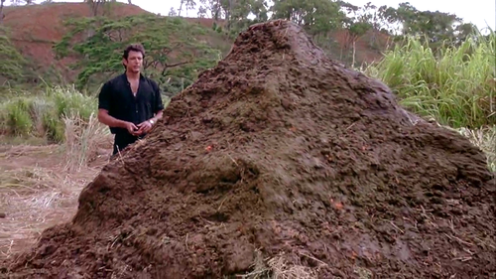
Goals
http://3.bp.blogspot.com/-Ym3C8SHTI6o/Tzx9wTiI46I/AAAAAAAAALo/elfVtY5CjUc/s1600/jurassic+poo.png
Notes:
And some are just big piles of crap ☺. For whatever reason, people will spread false information, and unfortunately they can permeate into people’s internal knowledge base. We won’t cover a lot of these, but we will address a couple of them

Slide 10
Goals
Inference
Structs and Classes
Gotos
Async
Recursion
Call Stacks
Exceptions
Variance
Overloading
IDisposable
Performance
Notes:
Here are the topics we’re going to address.

Slide 11

Goals
http://static3.bustaflash.com/funnystuff/gifs/holdmybeer/hold.jpg
Notes:
One final note. Before we dive in, you may say….”hey, if someone just read the documentation, they wouldn’t mess it up!” But most people DON’T do that. They just dive right in and hold on to bad assumptions. Or, frankly, sometimes the documentation is misleading (we’ll see that with IDisposable later).

Slide 12



Myths - Inference
Myth: The “var” keyword makes your variables dynamic
Notes:
We’ll start out simple
Myth: I still hear people say this about “var”. Nothing could be further from the truth. This isn’t Clojure, Ruby or Python (though those languages are cool too).

Slide 13
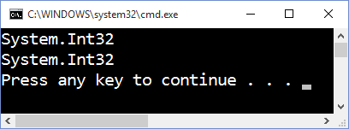
Myths - Inference
int xExplicit = 41;
Console.Out.WriteLine(xExplicit.GetType().FullName);
var xInferred = 44;
Console.Out.WriteLine(xInferred.GetType().FullName);
Notes:
It’s very simple. All “var” does is infer the type for you. In this case, the output is exactly the same. “xInferred” is an int; you can’t change it to a string later on.

Slide 14
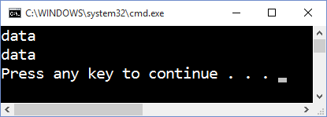
Myths - Inference
Dictionary<int, string> pairsExplicit =
new Dictionary<int, string> { { 22, "data" } };
Console.Out.WriteLine(pairsExplicit[22]);
var pairsInferred =
new Dictionary<int, string> { { 22, "data" } };
Console.Out.WriteLine(pairsInferred[22]);
Notes:
Where “var” shines is with long type names, like, anything longer than 3 characters ☺

Slide 15
Myths - Inference
public interface IBase
{
void DoSomething();
}
public class ABase : IBase
{
public void DoSomething() { }
}
public class BBase : IBase
{
public void DoSomething() { }
}
Notes:
Nothing is perfect though. Let’s say I had the following inheritance structure.

Slide 16
Myths - Inference
var varBase = xExplicit % 2 == 0 ?
new ABase() as IBase : new BBase();
varBase.DoSomething();
IBase varBaseViaIf = null;
if (xExplicit % 2 == 0)
{
varBaseViaIf = new ABase();
}
else
{
varBaseViaIf = new BBase();
}
varBaseViaIf.DoSomething();
Notes:
Note that even though both types inherit from IBase, the ternary operator doesn’t know that. So you have to cast the first type. That, or use an if statement.

Slide 17
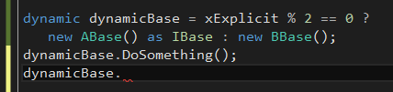
Myths - Inference
dynamic dynamicBase = xExplicit % 2 == 0 ?
new ABase() as IBase : new BBase();
dynamicBase.DoSomething();
Notes:
Even with dynamic, I still need the cast. And when you use dynamic, you get no Intellsense.

Slide 18

Myths - Structs and Classes
Myth: Structs on the stack, classes on the heap
http://2.bp.blogspot.com/-DeOGxaSZKqU/TpKu0O0MjJI/AAAAAAAAAVs/nJf426bn3Ik/s1600/confused.jpg
Notes:
Myth: This is a common one. If you make a struct, an instance of it always goes on the stack, class instances go on the heap.

Slide 19

Myths - Structs and Classes
HEAP
GC
MEMORY
ALLOCATION
http://getcookingsimply.com/wp-content/uploads/2010/06/AsianCaesarColorAdj200crop.jpg
Notes:
We could start getting into a whole word salad of technical terms, but the key part of this debate is the design-time semantics of reference and value types. Where they are stored is completely immaterial.

Slide 20
Myths - Structs and Classes
public sealed class ReferenceData
{
public ReferenceData(int data)
{
this.Data = data;
}
public void Increment()
{
this.Data++;
}
public int Data { get; private set; }
}
Notes:
Here’s a quick example. This is a reference type.

Slide 21
Myths - Structs and Classes
public struct ValueData
{
public ValueData(int data)
{
this.Data = data;
}
public void Increment()
{
this.Data++;
}
public int Data { get; private set; }
}
?
Notes:
Here’s a value type. Both are the same except for the “struct” and “class” definitions. Usually value types are immutable, but I’m doing this on purpose to prove a point.

Slide 22
Myths - Structs and Classes
static void Main(string[] args)
{
var referenceData1 = new ReferenceData(1);
var referenceData2 = referenceData1;
referenceData1.Increment();
var valueData1 = new ValueData(1);
var valueData2 = valueData1;
valueData1.Increment();
Console.Out.WriteLine($"{nameof(referenceData1)}: {referenceData1.Data}");
Console.Out.WriteLine($"{nameof(referenceData2)}: {referenceData2.Data}");
Console.Out.WriteLine($"{nameof(valueData1)}: {valueData1.Data}");
Console.Out.WriteLine($"{nameof(valueData2)}: {valueData2.Data}");
}
Notes:
Now, what will this do?

Slide 23
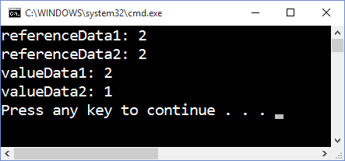
Myths - Structs and Classes
Notes:
The value type is copied. The reference type is referenced. That’s it.

Slide 24
Myths - Structs and Classes
“…in the Microsoft implementation of C# on the desktop CLR, value types are stored on the stack when the value is a local variable or temporary that is not a closed-over local variable of a lambda or anonymous method, and the method body is not an iterator block, and the jitter chooses to not enregister the value.”
https://blogs.msdn.microsoft.com/ericlippert/2010/09/30/the-truth-about-value-types/
Notes:
This is a more precise definition. In some cases even a struct (or value type) isn’t on the stack, though it’s pretty rare.

Slide 25
Myths - Structs and Classes
“Finally, the CLR does allow ‘ref return types’; you could in theory have a method ‘ref int M() { … }’ that returned a reference to an integer variable. If for some bizarre reason we ever decided to allow that in C#, we’d have to fix up the compiler and verifier so that they ensured that it was only possible to return refs to variables that were known to be on the heap, or known to be ‘lower down’ on the stack than the callee.”
https://blogs.msdn.microsoft.com/ericlippert/2009/05/04/the-stack-is-an-implementation-detail-part-two/
Notes:
As an aside, C#7 will allow for ref returns and ref locals ☺

Slide 26

Myths - Structs and Classes
https://hdwallpapers.press/wallpaper_mirror/relax_beach_sky_blue_summer_sea_nature_hd-wallpaper-100345.jpg
Notes:
So, just relax ☺. The definition doesn’t really matter. While structs may be faster in some cases because of their default storage mechanism, only with performance metrics in hand should you consider changing your designs from a class to a struct.

Slide 27
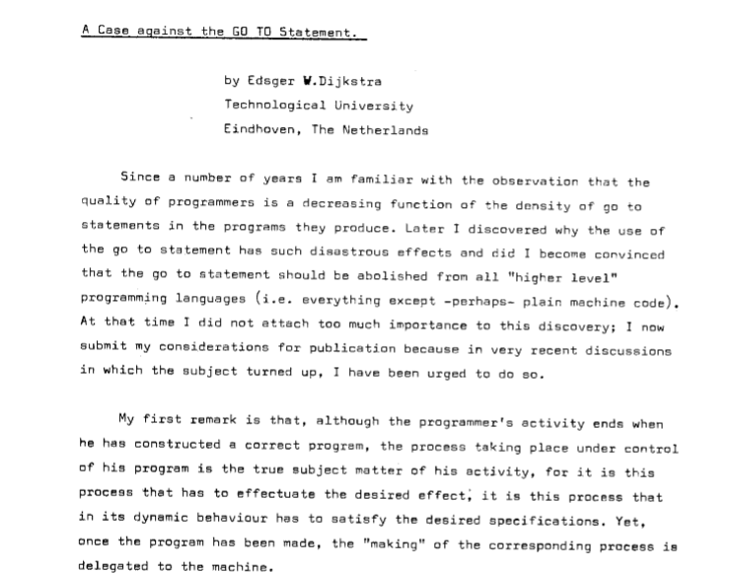
Myths - Goto
Myth: Gotos are not allowed in C#
"The unbridled use of the go to statement has as an immediate consequence that it becomes terribly hard to find a meaningful set of coordinates in which to describe the process progress. ... The go to statement as it stands is just too primitive, it is too much an invitation to make a mess of one's program.“ - Edsger Dijkstra
http://www.cs.utexas.edu/users/EWD/ewd02xx/EWD215.PDF
Notes:
Myth: Gotos are not allowed in C#. This is a modern language, right? And …. Dijkstra!!

Slide 28
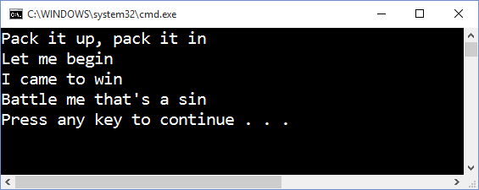
Myths - Goto
private static void JumpAround()
{
goto firstLine;
secondLine:
Console.Out.WriteLine("Let me begin");
goto thirdLine;
firstLine:
Console.Out.WriteLine("Pack it up, pack it in");
goto secondLine;
fourthLine:
Console.Out.WriteLine("Battle me that's a sin");
goto finish;
thirdLine:
Console.Out.WriteLine("I came to win");
goto fourthLine;
finish:
return;
}
Notes:
The sad fact is that gotos are valid in C#.

Slide 29
Myths - Goto
private static void JumpAroundGotoFree()
{
Console.Out.WriteLine("Pack it up, pack it in");
Console.Out.WriteLine("Let me begin");
Console.Out.WriteLine("I came to win");
Console.Out.WriteLine("Battle me that's a sin");
}
Notes:
This is so much simpler, right?

Slide 30
Myths - Goto
private static void CheckArgument(string value)
{
if(value == null)
{
throw new ArgumentNullException(
nameof(value));
}
}
IL_0000: nop
IL_0001: ldarg.0
IL_0002: ldnull
IL_0003: ceq
IL_0005: stloc.0
IL_0006: ldloc.0
IL_0007: brfalse.s IL_0015
IL_0009: nop
IL_000a: ldstr "value"
IL_000f: newobj instance void
[mscorlib]System.ArgumentNullException::.ctor(string)
IL_0014: throw
IL_0015: ret
Notes:
Now, at the IL level, you can do branches (conditional or unconditional). This is fairly typical with assembly instructions or intermediate formats like IL. But it’s not something that I’ve ever had a need to use in C#.

Slide 31
Myths - Goto
1 method…8 gotos
Notes:
Unfortunately, I did see it used and abused once 8 years ago.

Slide 32

Myths - Goto
http://www.psychicdonut.com/wp-content/uploads/2014/06/common-sense-just-because-you-can-doesn-t-mean-you-should.jpg
Notes:
Just because you CAN do something, doesn’t mean you should ☺

Slide 33

Myths - Async
Myth: Async code uses new threads, and is always async
http://impossible-world.blogspot.com/2009/08/impossible-structure.html
Notes:
Myth: While threads, concurrent programming, etc are old topics, async/await in C# is relatively new, and there are some misconceptions about them.

Slide 34
Myths - Async
private static async Task WriteAsync()
{
var client = new HttpClient();
var vsLiveData =
await client.GetStringAsync("http://www.vslive.com");
await Console.Out.WriteLineAsync(vsLiveData);
}
1
2
3
IOCP
Notes:
Async code is all about continuations. If you looked at the generated code it ends up looking like a huge state machine (with gotos ☺). The interesting part is the “cloud”. Not necessarily the buzzword “cloud”, but the ethereal “cloud” where code goes when an await happens. This is known as an I/O completion port. The details get pretty involved with these, but essentially a piece of I/O work that will “wait” for the OS to tell the application that’s it’s completed. The state machine will then pick up where the async work left off.

Slide 35
Myths - Async
NativeOverlapped* intOverlapped = asyncResult.OverLapped;
// ...
intOverlapped->OffsetLow = (int)_pos;
intOverlapped->OffsetHigh = (int)(_pos>>32);
// ...
int r = WriteFileNative(
_handle, bytes, offset, numBytes, intOverlapped, out hr);
http://referencesource.microsoft.com/#mscorlib/system/io/filestream.cs,157c7e73144c9238
Notes:
It’s a little easier to see with the FileWriter.WriteAsync() code. You can see the usage of an Overlapped structure, which is used in native async File I/O call.

Slide 36
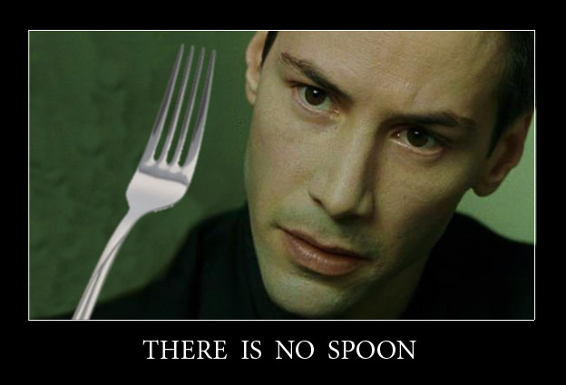
Myths - Async
https://darkdestiny.de/wp-content/uploads/2012/02/ThereIsNoSpoon.jpg
Notes:
The point is, there is no new or pooled thread that is used to process the async I/O request. There is no thread. The continuation may happen on the same thread, or a different one. That’s the job of the SynchronizationContext. But since no thread is involved in async I/O, the application can service other requests, which can make applications scalable because threads blocking on I/O has been eliminated.

Slide 37
Myths - Async
[MethodImplAttribute(MethodImplOptions.Synchronized)]
[ComVisible(false)]
public override Task WriteLineAsync(String value)
{
WriteLine(value);
return Task.CompletedTask;
}
http://referencesource.microsoft.com/#mscorlib/system/io/textwriter.cs,8ca1636fb9d6531f
Notes:
It’s interesting to note that just because a method returns a Task that it is asynchronous. The TextWriter’s WriteLineAsync(), which is what the Out property is on the Console class, is completely synchronous. You can still await it, but it will immediately return (note that the state machine created is smart enough to check if a Task is done before it enters the state machine logic as an optimization).

Slide 38
Myths - Async
private static async Task RunNewTask()
{
await Task.Run(() => Task.Delay(1000));
}
Notes:
It’s also possible that an async method will do work on another thread, either by using Task.Run() or Task.Factory.StartNew();

Slide 39
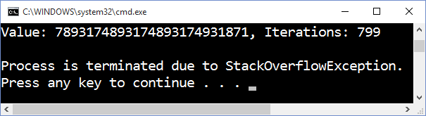
Myths - Recursion
Myth: Recursion can blow the stack
private BigInteger GetIterations(
BigInteger currentValue, BigInteger iterations)
{
iterations++;
currentValue = this.GetNextValue(currentValue);
if(currentValue == BigInteger.One)
{
return iterations;
}
else
{
return this.GetIterations(currentValue, iterations);
}
}
Notes:
Myth: Recursions left unchecked will always blow the stack.

Slide 40
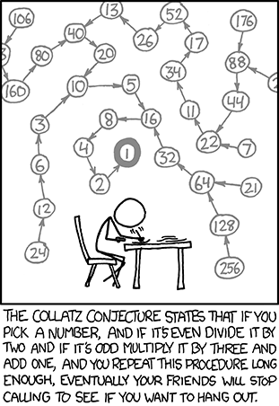
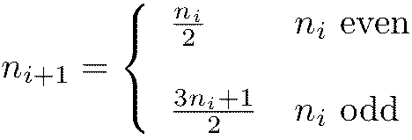
Myths - Recursion
http://users.aber.ac.uk/rob21/Code/Collatz/maths.jpg
http://xkcd.com/710/
Notes:
First, let’s start with a very simple algorithm, the Collatz Conjecture

Slide 41
Myths - Recursion
private BigInteger GetNextValue(BigInteger value)
{
return value % 2 == 0 ?
value / 2 : (3 * value) + 1;
}
Notes:
To implement it is pretty easy, but as you saw in a previous slide, calling this in a recursive function can cause the call stack to blow up

Slide 42
Myths - Recursion
private BigInteger GetIterations(BigInteger value)
{
var iterations = 0;
var currentValue = value;
while(currentValue > 1)
{
currentValue = this.GetNextValue(currentValue);
iterations++;
}
return iterations;
}
Notes:
You can usually change a recursive function into a while loop to remove the chance of getting a StackOverflowException

Slide 43
Myths - Recursion
IL_0022: ldarg.2
tail.
IL_0023: call instance valuetype
[System.Numerics]System.Numerics.BigInteger
CollatzConjectureWithIL.CollatzConjectureUsingTailCall::GetIterations(
valuetype [System.Numerics]System.Numerics.BigInteger,
valuetype [System.Numerics]System.Numerics.BigInteger)
IL_0028: ret
Notes:
But there’s another way, which unfortunately requires you to dive into IL. You put a .tail opcode just before the method invocation. This only works if the method invocation is immediately followed by a ret op code. This essentially wipes out the stack, so recursive functions (if they’re set up this way) won’t cause a StackOverflowException.

Slide 44
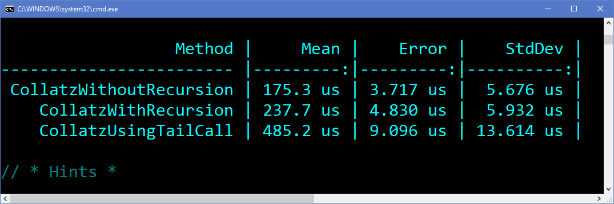
Myths - Recursion
Notes:
Note the performance of using tail calls.

Slide 45
Demo: Assembly Creation With IL
Busting .NET Myths
Notes:
Let’s walk through the process of taking C# code and modifying it with IL.

Slide 46
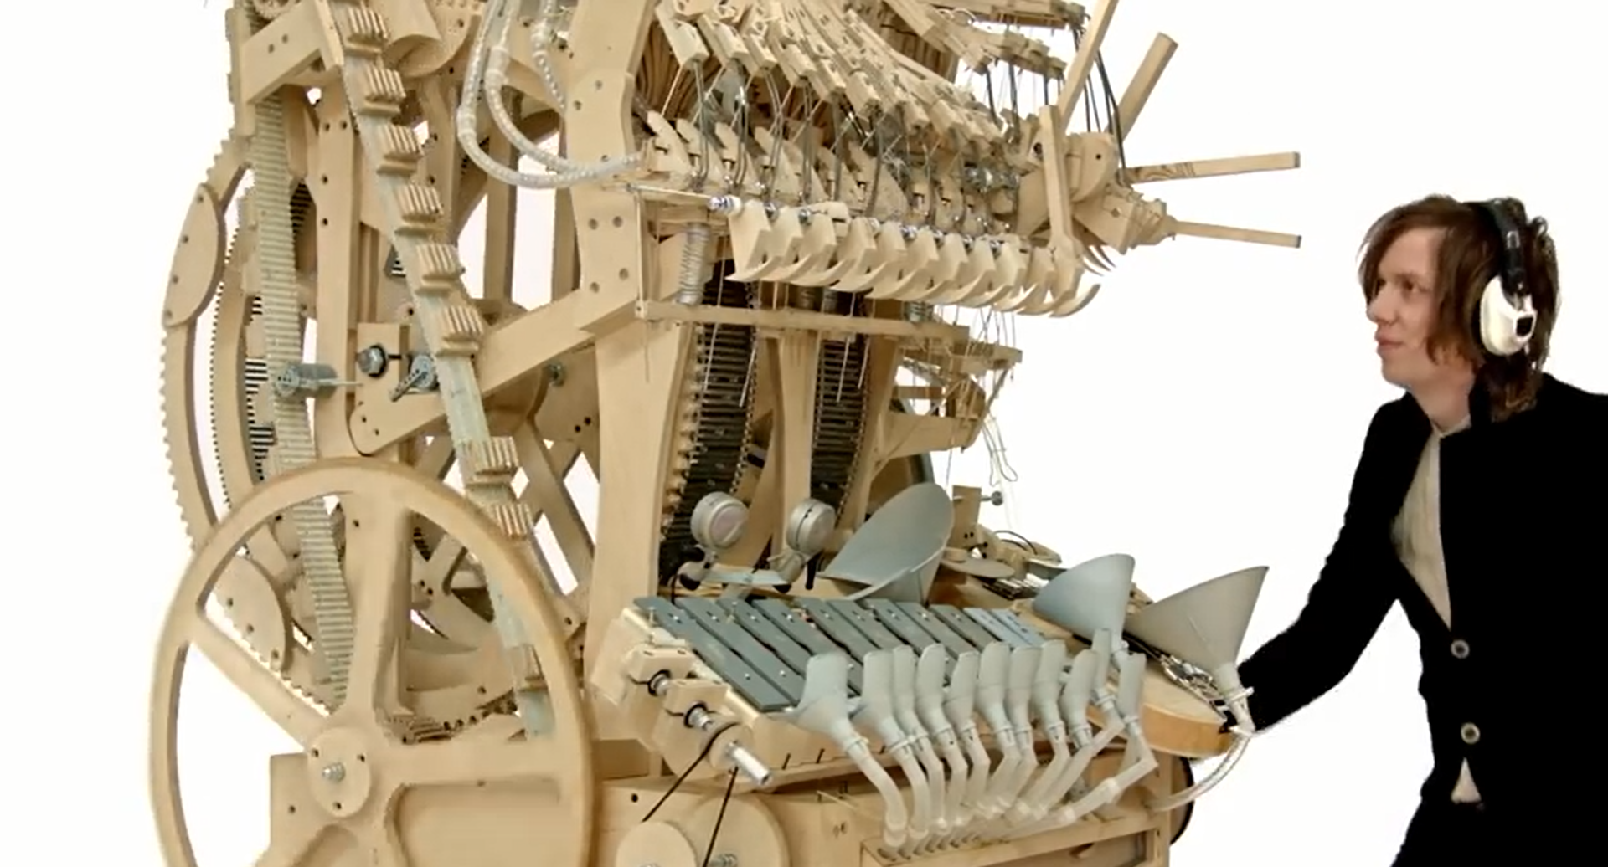
Myths - Recursion
https://www.youtube.com/watch?v=IvUU8joBb1Q
Notes:
The rules around what languages like C# and F# and the CLR will do with recursion and tail calls is…complicated. The notes section on the last slide provides links to articles with deep details on this issue.

Slide 47

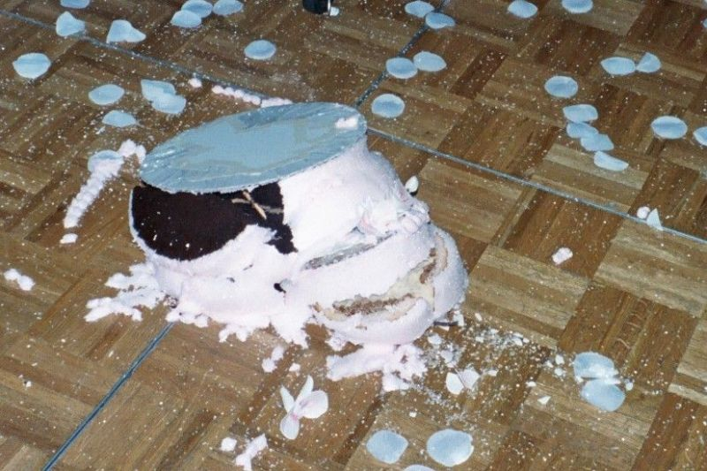
Myths - Call Stacks
Myth: Call stacks always make logical sense
http://redstaplerchronicles.com/wp-content/uploads/2011/06/ruined-wedding-cake.jpg
Notes:
Speaking of call stacks….if you don’t know how call stacks work, they can surprise you in the end, and everything falls apart.

Slide 48
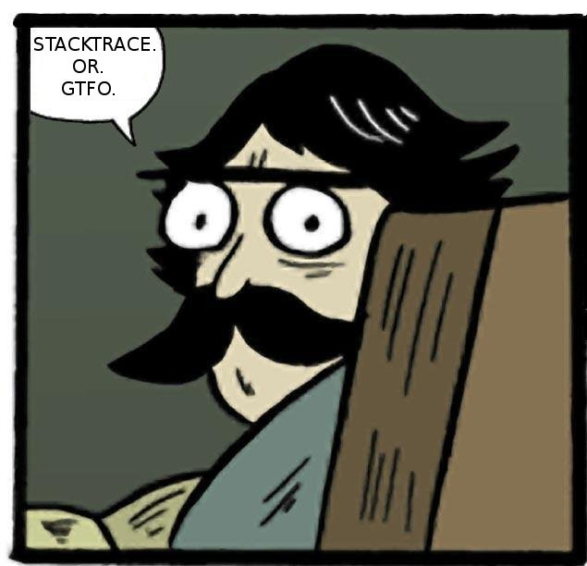
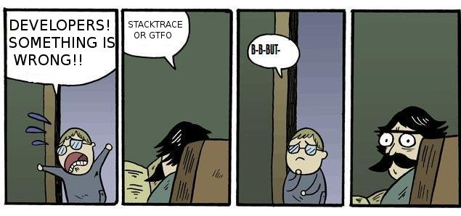
Myths - Call Stacks
http://imgur.com/jacoj
Notes:
We live for call stacks. If we run into an unhandled exception, getting the call stack is a base line requirement to have any chance of figuring out what went wrong.

Slide 49
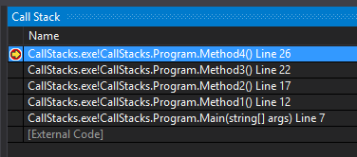
Myths - Call Stacks
Method1
Method2
Method3
Method4
Notes:
Developers usually think linearly when it comes to call stacks. If I put a breakpoint in Method4(), I’d expect to see what I do see in VS.

Slide 50
Myths - Call Stacks
[MethodImpl(MethodImplOptions.AggressiveInlining)]
private static void GetCallingFrame()
{
var frame = new StackFrame(1);
Console.Out.WriteLine(frame.GetMethod().Name);
}
Notes:
But inlining can get in the way. In this code, it’s going to try and force .NET to inline the method (FYI this isn’t a 100% guarantee. Running code with a Debug build doesn’t seem to force it, but a Release build with optimizations seems to work).

Slide 51
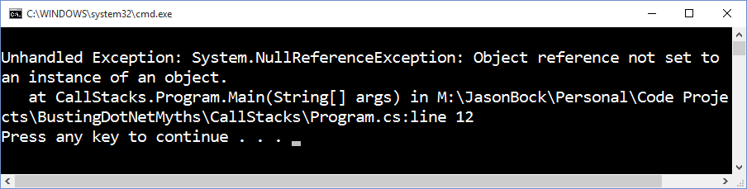
Myths - Call Stacks
static void Main(string[] args)
{
Program.GetCallingFrame();
}
Notes:
In this case, because there isn’t anything calling GetCallingFrame() as it’s been inlined, assuming something will be on the call stack will cause an error.

Slide 52
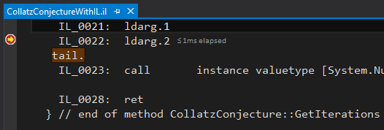

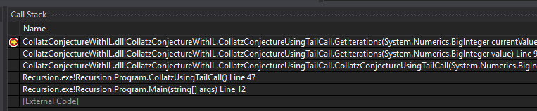
Myths - Call Stacks
Notes:
Tail calls can also make the stack look weird. In this case, the Collatz class that uses a tail call has been called recursively but we only see one GetIterations(BigInteger, BigInteger) on the call stack.

Slide 53
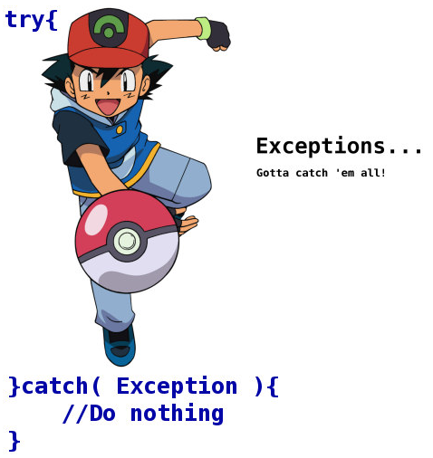
Myths - Exceptions
Myth: Let’s catch all exceptions to make the application stable!
http://24.media.tumblr.com/tumblr_lpflmeeqfz1ql3fxto1_500.jpg
Notes:
Speaking of exceptions….someone may look at the previous example, and say, “just put a catch block around it so the StackOverflowException doesn’t happen. In fact, just swallow it!”

Slide 54
Myths - Exceptions
try
{
var collatz = new CollatzConjecture(
Numbers.NumberThatWillAlwaysCauseStackOverflow);
Console.Out.WriteLine(
$"Value: {collatz.Value}, Iterations: {collatz.Iterations}");
}
catch { }
Notes:
In other words, do something like this code. But that won’t help. A StackOverflowException cannot be caught no matter what you do in .NET. (In 1.0 and 1.1, you could, but not since 2.0).

Slide 55
Myths - Exceptions
StackOverflowException
ThreadAbortException
Corrupted State Exceptions (e.g. AccessViolationException)
Notes:
Here’s a list of exceptions that are difficult or “impossible” to catch:
StackOverflowException. Note, it can be caught if you’re hosting the CLR yourself, but that’s an extreme example
ThreadAbortException. It can be caught, but it’ll be re-raised after your catch block
CSEs, they can’t be caught unless you mark a method with [HandleProcessCorruptedStateExceptions]. There are other ways to do it via configuration, and it also depends on the security trust of the executed code.

Slide 56
Myths - Exceptions
try
{
int.Parse(ParseVsTryParse.BadValue);
}
catch (FormatException) { }
// Versus...
var result = 0;
int.TryParse(ParseVsTryParse.BadValue, out result);
Notes:
But it’s not just what you can’t catch. It’s the performance hit that you take when you catch an exception, especially if all you do is “log-then-rethrow” or swallow it. For example, .NET used to (and still has) Parse() on a number of core value types. But TryParse() was introduced in 2.0, and it is the preferred approach, primarily for eliminating the need to catch an exception.

Slide 57
Myths - Exceptions
Parse() Implementation
TryParse() Implementation
if ((style & NumberStyles.AllowHexSpecifier) != 0) {
if (!HexNumberToInt32(ref number, ref i)) {
throw new OverflowException(
Environment.GetResourceString("Overflow_Int32"));
}
}
else {
if (!NumberToInt32(ref number, ref i)) {
throw new OverflowException(
Environment.GetResourceString("Overflow_Int32"));
}
}
return i;
if ((style & NumberStyles.AllowHexSpecifier) != 0) {
if (!HexNumberToInt32(ref number, ref result)) {
return false;
}
}
else {
if (!NumberToInt32(ref number, ref result)) {
return false;
}
}
return true;
http://referencesource.microsoft.com/#mscorlib/system/int32.cs,225942ed7b7a3252,references
Notes:
It’s interesting to note that the implementations of the two approaches are virtually identically, save that one throws, and the other returns a boolean.

Slide 58
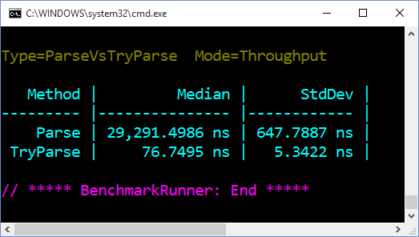
Myths - Exceptions
TryParse() Implementation: 3 orders of magnitude faster
Notes:
But the performance differences between the two are astounding. TryParse() is 3 orders of magnitude faster

Slide 59
Demo: Timing Exceptions
Busting .NET Myths
Notes:
Let’s show Benchmark.net and how simple it was to do that exception timing.

Slide 60
Myths - Variance
Myth: List assignments don’t make sense
Puzzle
IList<Puzzle> puzzles =
new List<CombinationPuzzle>();
CombinationPuzzle
Won’t work!
Notes:
Myth: Type assignments don’t always make sense in .NET. Why can’t I do what’s in the code? Makes sense, right?

Slide 61
Myths - Variance
public interface IInvariantProducer<T>
where T : new()
{
T Produce();
}
public sealed class InvariantProducer<T>
: IInvariantProducer<T> where T : new()
{
public T Produce()
{
return new T();
}
}
Notes:
Let’s back up a second and look at a typical, invariant interface that most .NET developers make out of the gate.

Slide 62
Myths - Variance
var invariantPuzzleProducer = new InvariantProducer<Puzzle>();
var invariantCombinationPuzzleProducer =
new InvariantProducer<CombinationPuzzle>();
invariantPuzzleProducer = invariantCombinationPuzzleProducer;
IInvariantProducer<Puzzle> explicitInvariantProducer =
new InvariantProducer<CombinationPuzzle>();
Won’t work!
Notes:
Even though CombinationPuzzle inherits from Puzzle, and therefore it makes logical sense to do the assigments shown above, you can’t do it. The generics are invariant.

Slide 63
Myths - Variance
public interface ICovariantProducer<out T>
where T : new()
{
T Produce();
}
public sealed class CovariantProducer<T>
: ICovariantProducer<T> where T : new()
{
public T Produce()
{
return new T();
}
}
Notes:
But with a simple addition of the “out” keyword on the generic type from the interface definition

Slide 64
Myths - Variance
var covariantPuzzleProducer = new CovariantProducer<Puzzle>();
var covariantCombinationPuzzleProducer =
new CovariantProducer<CombinationPuzzle>();
covariantPuzzleProducer = covariantCombinationPuzzleProducer;
ICovariantProducer<Puzzle> explicitCovariantProducer =
new CovariantProducer<CombinationPuzzle>();
Won’t work!
Notes:
Now we can assign variables with the “base” type, if we use an explicit interface type definition when declaring the variable.

Slide 65
Myths - Variance
Variant type parameters are restricted to generic interface and generic delegate types
A generic interface or generic delegate type can have both covariant and contravariant type parameters.
Variance applies only to reference types; if you specify a value type for a variant type parameter, that type parameter is invariant for the resulting constructed type.
Variance does not apply to delegate combination.
https://msdn.microsoft.com/en-us/library/dd799517(v=vs.110).aspx
Notes:
These are the basic rules – essentially, variance is only for generic interfaces and delegates using reference types. There are far more details to co- and contravariance than this, but that’s the gist of it.

Slide 66
Myths - Variance
public interface IList<T>
: ICollection<T>, IEnumerable<T>, IEnumerable
{
// ...
T this[int index] { get; set; }
// ...
}
http://referencesource.microsoft.com/#mscorlib/system/collections/generic/ilist.cs,b19f71a84062554b
Notes:
Now, an interface cannot define a generic type to be covariant and contravariant at the same time. This partial description of the IList interface shows why it can never have variance, because T is used as an argument and as a return value on an indexer.

Slide 67
Myths - Variance
public interface IVariantList<out TOut, in TIn>
{
TOut Get(int index);
void Set(int index, TIn value);
int IndexOf(TIn item);
}
Notes:
We could TRY to create a variant IList type…but it would be very limited. Essentially the base interface types would have to be re-designed, which may cause a large number of breaking changes to existing types. Also, we’d like the two generics types to be exactly the same types, but you can’t do this:
where TOut : TIn
where TIn : TOut
That creates a circular dependency that the compiler won’t allow (CS0454 - https://msdn.microsoft.com/en-us/library/4y95z473(v=vs.90).aspx). It’s possible to create an analyzer to do this check for us on interfaces where we want this “exactness” on generic type parameters, but that wouldn’t be enforced if someone created an instance of a class that inherits from this interface via Reflection. Furthermore, there is no relationship between TOut and TIn

Slide 68
Myths - Variance
public interface IVariantList<in TIn, out TOut>
where TIn : TOut
{
TOut Get(int index);
void Set(int index, TIn value);
int IndexOf(TIn item);
}
Notes:
If we add a constraint such that TIn has to be of a type Tout….

Slide 69
Myths - Variance
public sealed class VariantList<TIn, TOut>
: IVariantList<TIn, TOut>
where TIn : TOut
{
private readonly List<TIn> items = new List<TIn>();
public TOut Get(int index)
{
return this.items[index];
}
// ...
Notes:
We could have something that starts looking a little sane, but it’s still not very clean

Slide 70
Myths - Variance
// ...
public int IndexOf(TIn item)
{
return this.items.IndexOf(item);
}
public void Set(int index, TIn value)
{
this.items[index] = value;
}
}
Notes:
Essentially, this is why IList<T> isn’t variant.

Slide 71
Myths - Variance
public interface IReadOnlyList<out T>
: IReadOnlyCollection<T>, IEnumerable<T>, IEnumerable
{
T this[int index] { get; }
// Inherited members are also covariant.
}
IReadOnlyList<Puzzle> puzzles = new List<CombinationPuzzle>();
// Note: this doesn’t work
IReadOnlyList<Puzzle> puzzles =
new ReadOnlyCollection<Puzzle>(new List<CombinationPuzzle>());
Notes:
But, IReadOnlyList<T> IS covariant, because it’ll only have T involved in return values.

Slide 72

Myths - Overloading
Myth: You can’t overload methods by return type only
public int Run(int a)
{
return 0;
}
public Guid Run(int a)
{
return Guid.NewGuid();
}
http://stream1.gifsoup.com/view7/4332044/delta-not-allowed-o.gif
Notes:
Myth: Most C# developers know the basics of method overloading, one of which is you can’t override a method by return type only.

Slide 73
Myths - Overloading
public void Run(int a) { }
public void Run(Guid a) { }
public void Run(int a, string b) { }
“When two or more members in a type are the same kind of member (method, property, constructor, and so on) and have the same name and different parameter lists, the member is said to be overloaded.”
https://msdn.microsoft.com/en-us/library/ms229029(v=vs.100).aspx
Notes:
Let’s back up a second. Method overloading is defined this way. For simple cases, it’s not hard to figure out which method would be called.

Slide 74
Myths - Overloading
public static void CallIt<T>(object o, T t)
{
Console.Out.WriteLine("object o, T t");
}
public static void CallIt<T>(T t, object o)
{
Console.Out.WriteLine("T t, object o");
}
//Program.CallIt(new object(), new object());
//Program.CallIt(new Program(), new Program());
Program.CallIt(new object(), new Program());
Notes:
For more complex scenarios, it can be difficult to figure out if it’s valid, and even if it is, which method will get invoked. The first two calls won’t even been allows as they are ambiguous, but the third one works.

Slide 75
Myths - Overloading
public static void CallItA<T>(object o, T t)
{
Console.Out.WriteLine("object o, T t");
}
public static void CallItB<T>(T t, object o)
{
Console.Out.WriteLine("T t, object o");
}
Program.CallItB(new object(), new object());
Program.CallItA(new Program(), new Program());
Notes:
A very simple way to get around this is to change the name of the method (if you can control that). Some programming languages (like Eiffel) don’t support method overloading at all, which removed a fair amount of ambiguity.

Slide 76
Myths - Overloading
3.6 Signatures and overloading
The signature of a method consists of the name of the method and the type and kind (value, reference, or output) of each of its formal parameters, considered in the order left to right. The signature of a method specifically does not include the return type, nor does it include the params modifier that may be specified for the right-most parameter.
https://msdn.microsoft.com/en-us/library/aa691131%28v=vs.71%29.aspx?f=255&MSPPError=-2147217396
Notes:
Now, it’s very clear according to the C# specification that the signature of a method ignores the return type. But….

Slide 77
Myths - Overloading
.method public hidebysig instance int32
GetValue() cil managed
{
.maxstack 8
ldc.i4 0x64
ret
}
.method public hidebysig instance string
GetValue() cil managed
{
.maxstack 8
ldstr "100"
ret
}
Notes:
In IL, you can do this. When you call a method in IL, you give the return value as well, so there’s no ambiguity

Slide 78
Myths - Overloading
call instance int32 [Overloaded] Overloaded.ValueGenerator::GetValue()
ValueGenerator
int32 GetValue()
string GetValue()
call instance string [Overloaded] Overloaded.ValueGenerator::GetValue()
Notes:
In IL, you can do this. When you call a method in IL, you give the return value as well, so there’s no ambiguity

Slide 79
Myths - Overloading
var generator = new ValueGenerator();
var getValueIntMethod = typeof(ValueGenerator)
.GetMethods()
.Single(_ => _.Name == nameof(ValueGenerator.GetValue) &&
_.ReturnType == typeof(int));
var value = getValueIntMethod.Invoke(generator, null);
Console.Out.WriteLine(
$"{value}, type is {value.GetType().Name}");
Notes:
It’s possible to call these methods in C#, you just need to do some Reflection magic.

Slide 80
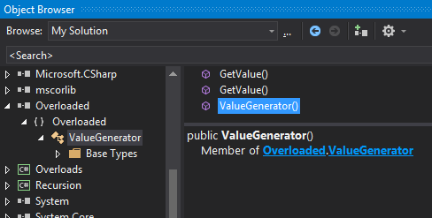
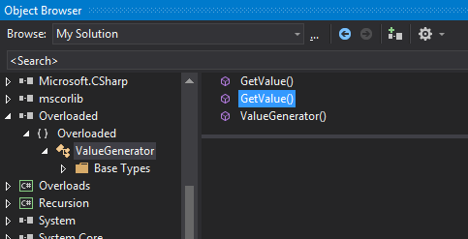
Myths - Overloading
?
Notes:
Note that the Object Browser in VS gets very confused with this setup.

Slide 81

Myths - Overloading
http://img08.deviantart.net/8870/i/2004/215/b/2/evil_eyes.jpg
Notes:
This is pretty evil to do to others, so I’d advise you not to do this …. often ;)

Slide 82

Myths - IDisposable
Myth: Disposable objects get special treatment from the CLR
http://www.bitsandpieces.us/wp-content/uploads/2013/06/pampered-cat.jpg
Notes:
Myth: If you make a class implement IDisposable, the CLR will clean things up for you, even if you forget to call Dispose().

Slide 83
Myths - IDisposable
public sealed class UnmanageableResource
{
public void Free() { /* interesting code goes here... */ }
}
public class UsesUnmanageableResource
{
private readonly UnmanageableResource resource =
new UnmanageableResource();
}
// ...
var user = new UsesUnmanageableResource(); // No Free() call!
Notes:
Let’s start with the basics. You have some object that requires cleanup outside of the of the CLR’s memory management universe. Network connections, memory allocations …. It’s something that the CLR is not aware of, so you can’t rely upon the CLR to GC it. If you use it in a class…disaster awaits.

Slide 84
Myths - IDisposable
public class UsesUnmanageableResourceCorrectly
: IDisposable
{
private readonly UnmanageableResource resource =
new UnmanageableResource();
public void Dispose()
{
this.resource.Free();
}
}
Notes:
Of course, we have a solution for it: IDisposable. But that’s not enough.

Slide 85
Myths - IDisposable
using(var uses = new UsesUnmanageableResourceCorrectly())
{
// Use uses here...
}
// This compiles with no issue.
var uses2 = new UsesUnmanageableResourceCorrectly();
Notes:
First, you have to remember to call Dispose() on it. That is easily enforceable via a using statement, but the compiler doesn’t enforce this.

Slide 86
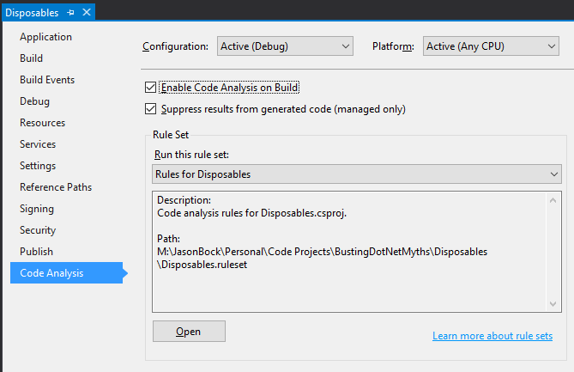
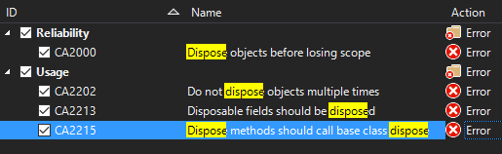
Myths - IDisposable
Notes:
You can enable Code Analysis rules to tell you when you’re not using IDisposable-based objects correctly.

Slide 87
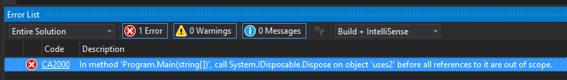
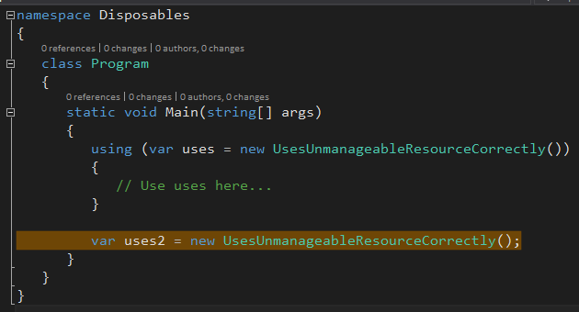
Myths - IDisposable
Notes:
Since this analysis happens post-compilation, the total compilation time may be longer, but you’ll end up catching errors like this before they get too far.

Slide 88
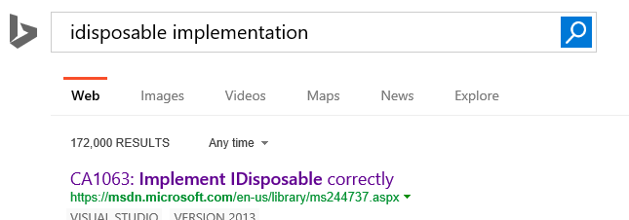
Myths - IDisposable
https://www.bing.com/search?q=idisposable%20implementation
Notes:
But we’re not done. The way I implemented IDisposable is not correct. The problem is….correct according to whom? Seems like a lot of people have opinions on this ☺

Slide 89
Myths - IDisposable
IDisposable is re-implemented in the class.
Finalize is re-overridden.
Dispose is overridden.
Dispose() is not public, sealed, or named Dispose.
Dispose(bool) is not protected, virtual, or unsealed.
In unsealed types, Dispose() must call Dispose(true).
For unsealed types, the Finalize implementation does not call either or both Dispose(bool) or the case class finalizer.
https://msdn.microsoft.com/en-us/library/ms244737.aspx
Notes:
Let’s go with this list. It’s the one that’s related to Code Analysis item CA1063.

Slide 90
Myths - IDisposable
public class UsesUnmanageableResourceAndImplementsIDisposableCorrectly
: IDisposable
{
private IntPtr nativeResource = Marshal.AllocHGlobal(10);
private UnmanageableResource resource =
new UnmanageableResource();
public UsesUnmanageableResourceAndImplementsIDisposableCorrectly()
{
this.resource = new UnmanageableResource();
}
// ...
Notes:
So, here’s how you do it right. Note the addition of a “true” unmanaged resource.

Slide 91
Myths - IDisposable
public void Dispose()
{
this.Dispose(true);
GC.SuppressFinalize(this);
}
~UsesUnmanageableResourceAndImplementsIDisposableCorrectly()
{
this.Dispose(false);
}
Notes:
So, here’s how you do it right. Note the addition of a “true” unmanaged resource.

Slide 92
Myths - IDisposable
protected virtual void Dispose(bool disposing)
{
if (disposing)
{
if (this.resource != null)
{
this.resource.Free();
this.resource = null;
}
}
Notes:
So, here’s how you do it right. Note the addition of a “true” unmanaged resource.

Slide 93
Myths - IDisposable
if (nativeResource != IntPtr.Zero)
{
Marshal.FreeHGlobal(nativeResource);
nativeResource = IntPtr.Zero;
}
}
}
Notes:
So, here’s how you do it right. Note the addition of a “true” unmanaged resource.

Slide 94
Myths - IDisposable
UsesResourcesWithMembers usesWithMembers = null;
using(usesWithMembers = new UsesResourcesWithMembers())
{
// Use uses here...
}
var data = usesWithMembers.Data;
usesWithMembers.MarshallData(10);
Notes:
But we’re still not done. What happens if someone inadvertently does this? (Note: I’m unaware of a Code Analysis rule that will catch this, but if there is, we should be defensive);

Slide 95
Myths - IDisposable
public string Data => "Data";
public void MarshalData(int value)
{
Marshal.WriteInt32(this.nativeResource, value);
}
Notes:
With the property, it’s no big deal, but with MarshallData(), we have to be careful, because Dispose() may have been called.

Slide 96
Myths - IDisposable
public string Data
{
get
{
if(this.isDisposed)
{
throw new ObjectDisposedException(
nameof(UsesResourcesWithMembers));
}
return "Data";
}
}
https://msdn.microsoft.com/en-us/library/system.objectdisposedexception(v=vs.110).aspx
Notes:
What you should do is throw ObjectDisposedException

Slide 97
Myths - IDisposable
public void MarshalData(int value)
{
if (this.isDisposed)
{
throw new ObjectDisposedException(
nameof(UsesResourcesWithMembers));
}
Marshal.WriteInt32(this.nativeResource, value);
}
https://msdn.microsoft.com/en-us/library/system.objectdisposedexception(v=vs.110).aspx
Notes:
What you should do is throw ObjectDisposedException

Slide 98

Myths - IDisposable
http://horsesmouth.typepad.com/hm/Ouch500.jpg
Notes:
It looks painful, and … yes, you’re right, it is. You may decided to only throw ObjectDisposedException with members that may use a disposable resource, like MarshallData(), whereas the Data property is fine.

Slide 99

Myths - Performance
Myth: .NET is slooooooooooooooooooooow
https://media.giphy.com/media/nWcLvfOsjXWWQ/giphy.gif
Notes:
Myth: .NET is slow. GC pauses, memory bloat – if you want something to run fast, forget .NET

Slide 100
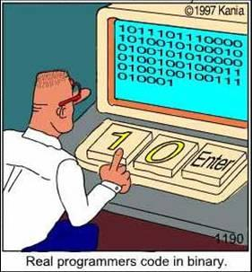
Myths - Performance
http://www.ibiblio.org/hhalpin/homepage/presentations/programmingtalk/RealProgrammers.jpg
Notes:
Now, if you really want the “bare metal” experience, assembly/machine code is probably the way to go, though it’s not a guarantee of fast code, and you better know what you’re doing.

Slide 101

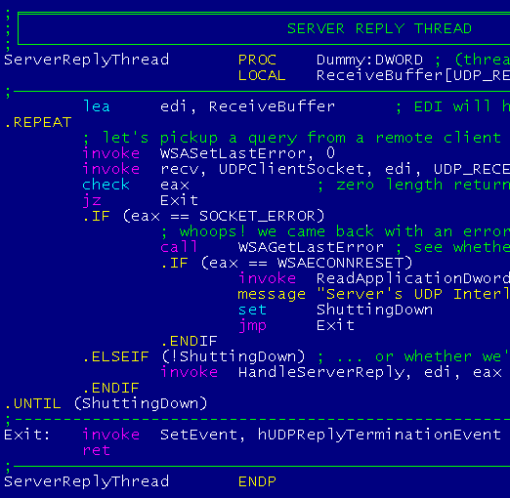
Myths - Performance
Assembly Language can be beautiful and legible…Am I sick? Perhaps. Am I a dinosaur destined for early extinction? Yeah, probably. But I truly love programming. It's what I do. It fulfills me and sustains me … and I'm never in a hurry to "just be done with it." I can't stand sloppiness in my work, so for me that means writing the smallest, tightest, fastest, most economical computer programs possible. And that means authoring Windows applications in Assembly Language.
Though the rest of the world may argue that they're more "productive" (when measured by hard disk space consumed per second), I stand by the principle that: "Small Is Beautiful".
https://www.grc.com/smgassembly.htm
Notes:
In fact there are people who take pride in writing their applications completely in assembly.

Slide 102

Myths - Performance
https://biblicaldiagnosis.files.wordpress.com/2013/10/balance-scale.jpg
Notes:
There’s always a balance. A managed language provides automatic memory collection so you don’t have to worry about it, but there’s a cost in having a GC present.

Slide 103
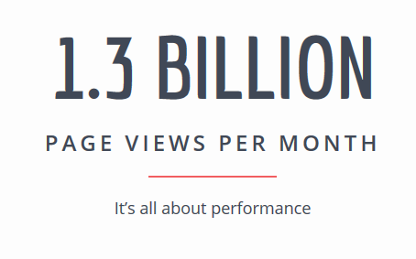

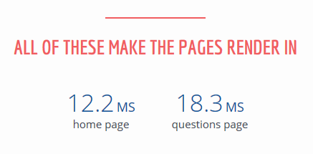
Myths - Performance
…as of 7/16/2018…
…
http://stackexchange.com/performance
Notes:
You can create very fast .NET applications without touching a lick of assembly. StackExchange is one example.

Slide 104
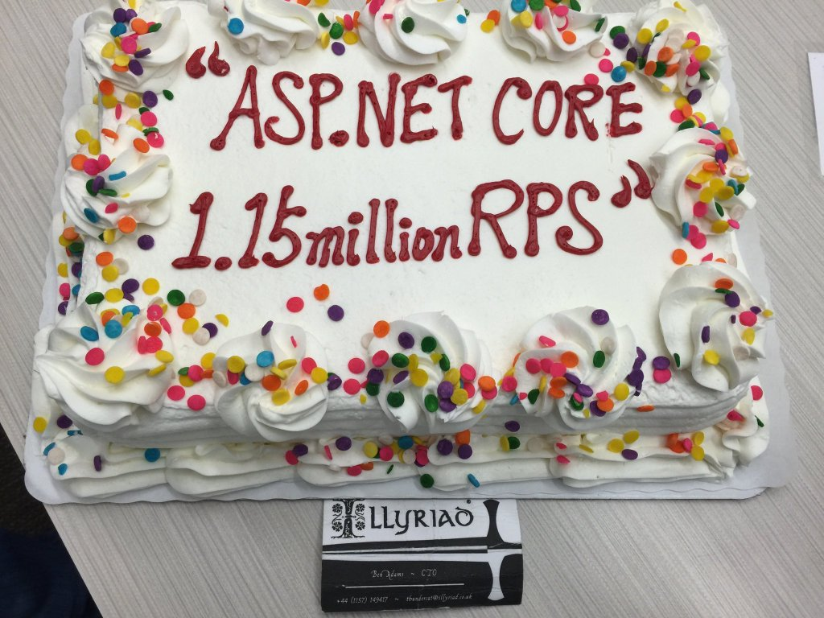
Myths - Performance
http://www.ageofascent.com/asp-net-core-exeeds-1-15-million-requests-12-6-gbps/
Notes:
ASP.NET Core has also brought to the table a lot of performance improvements. This comes for the Age of Ascent gaming folks, who are already using .NET Core in their system.

Slide 105

Myths - Performance
https://www.techempower.com/benchmarks/#section=data-r16&hw=ph&test=plaintext
Notes:
With the latest .NET Core release, ASP.NET Core is now #11 on the TechEmpower benchmark test for plaintext, and is moving up in other tests.

Slide 106

Summary
http://www.blueskyresumes.com/blog/wp-content/uploads/2014/03/lesson9.jpg
Notes:
In the end, remember to question yourself. The .NET, and in general programming, world is vast. Even after 14 years we can still get it wrong, and things are always in flux. Challenge your own assertions and make sure you’re correct to the best of your knowledge.

Slide 107
Busting .NET Myths
Jason Bock
Practice Lead
Remember…
https://github.com/JasonBock/BustingDotNetMyths
https://docs.com/jason-bock/4593/busting-net-myths
References in the notes on this slide
Notes:
* Nicole Calinoiu - Back to basics: Finalization and disposition in .NET - https://vimeo.com/9751950
* C# Myths - http://binaryserialization.blogspot.com/
* Five Myths about Managed Code - http://blogs.msdn.com/b/dotnet/archive/2009/10/02/five-myths-about-managed-code.aspx
* Weak Events in C#, Take Two - http://www.thomaslevesque.com/2015/08/16/weak-events-in-c-take-two/
* Dispose, Finalization, and Resource Management - http://joeduffyblog.com/2005/04/08/dg-update-dispose-finalization-and-resource-management/
* Proposal: Destructable Types - https://github.com/dotnet/roslyn/issues/161
* Implementing IDisposable
* https://msdn.microsoft.com/en-us/library/ms244737.aspx
* http://www.codeproject.com/Articles/15360/Implementing-IDisposable-and-the-Dispose-Pattern-P
* The theory behind covariance and contravariance in C# 4 - http://tomasp.net/blog/variance-explained.aspx/
* Covariance and Contravariance in Generics - https://msdn.microsoft.com/en-us/library/dd799517(v=vs.110).aspx
* Generate tail call opcode - http://stackoverflow.com/questions/15864670/generate-tail-call-opcode
* Tail recursion in C# - http://www.thomaslevesque.com/2011/09/02/tail-recursion-in-c/
* The Stack Is An Implementation Detail
* Part One: https://blogs.msdn.microsoft.com/ericlippert/2009/04/27/the-stack-is-an-implementation-detail-part-one/
* Part Two: https://blogs.msdn.microsoft.com/ericlippert/2009/05/04/the-stack-is-an-implementation-detail-part-two/
* The Truth About Value Types - https://blogs.msdn.microsoft.com/ericlippert/2010/09/30/the-truth-about-value-types/
* StackOverflowException Class - https://msdn.microsoft.com/en-us/library/system.stackoverflowexception.aspx
* ThreadAbortException Class - https://msdn.microsoft.com/en-us/library/system.threading.threadabortexception.aspx
* CLR Inside Out - Handling Corrupted State Exceptions - https://msdn.microsoft.com/en-us/magazine/dd419661.aspx#id0070035

